Slide 1
GPU Tessellation
Damon Rocco

Slide 2
Definition
Tessellation: The filling of a plane with polygons such that there is no overlap or gap.
In computer graphics objects are rendered as a triangular mesh
A triangle is always a plane
Thus, the triangles in a mesh can be tessellated to increase detail

Slide 3
Why Tessellate?
In software tessellation provides an interesting way of enhancing detail
In hardware tessellation allows a simple mesh to be sent down to the GPU, converted to a complex mesh, and then displayed
Decrease memory to the card
Increase rendering performance by decreasing the number of polygons through the full pipeline

Slide 4
Why Tessellate?
With programmable tessellation what objects get tessellated can be decided by the programmer
This allows for objects closer to the screen to be tessellated while objects far away are not
Detail actually increases as objects get closer instead of just getting bigger
Resources aren’t wasted on meshes that are too far away for tessellation effects to be viewed

Slide 5
Tessellation Hardware Roadmap
Xbox 360: ATI Xenos graphics chipset
The first geometry tessellation unit
“Programmable”
ATI Radeon HD 5xxx series
The first DX11 card
NVIDIA “Fermi”
NVIDIA’s first DX11 card

Slide 6
Tessellation Software Roadmap
DirectX 9: Dynamic Terrain Rendering on GPU Using Real-Time Tessellation. Natalya Tatarchuk. ATI Research published in ShaderX7
DirectX 10: Instanced Tessellation in DirectX10. Andrei Tatarinov. GDC ‘08
DirectX 11: New pipeline features three tessellation stages, 2 are programmable

Slide 7
Dynamic Terrain Rendering on GPU Using Real-Time Tessellation
Natalya Tatarchuk

Slide 8
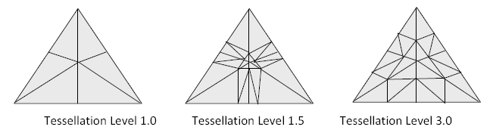
The Work
Goal: Create a software library that would allow tessellation exclusively on ATI cards.
Product: ATI GPU Tessellation library. An ATI only library that worked in conjunction with DirectX 9 (also 10.x) and was capable of tessellating meshes

Slide 9
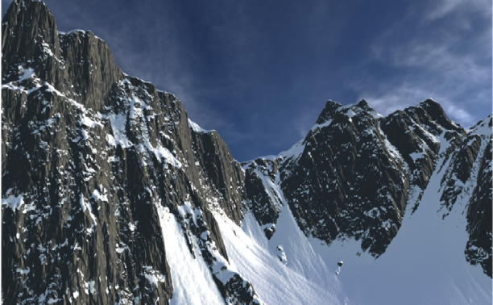
Paper Results
A flat 900 polygon grid becomes a 1,000,000 polygon mountain-scape at inter-actable rates

Slide 10
Instanced Tessellation in DirectX10
Andrei Tatarinov

Slide 11
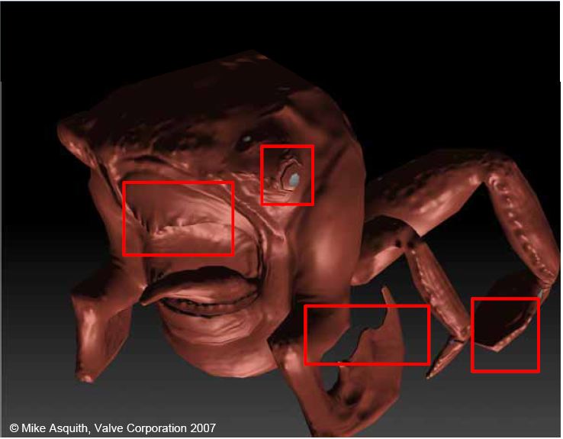
Introduction
In the past complex shading models were used to hide lack of detail in a polygonal mesh
They can only do so much…

Slide 12
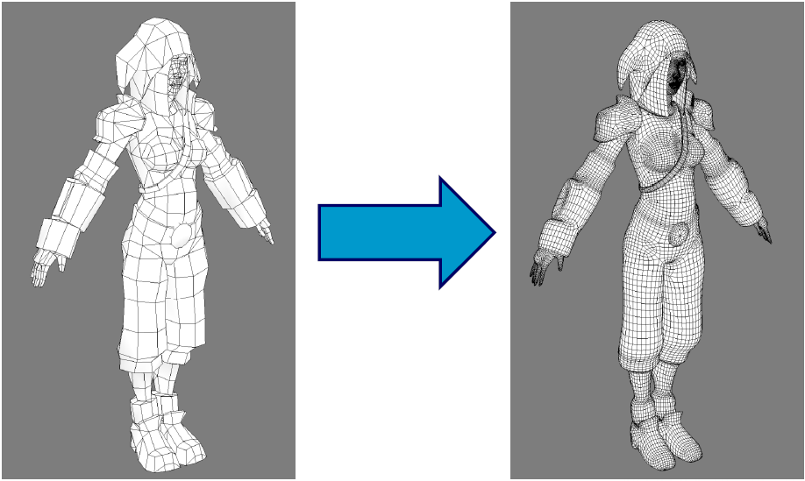
Introduction
The solution is to use on-the-card tessellation to increase the physical detail in the meshes

Slide 13
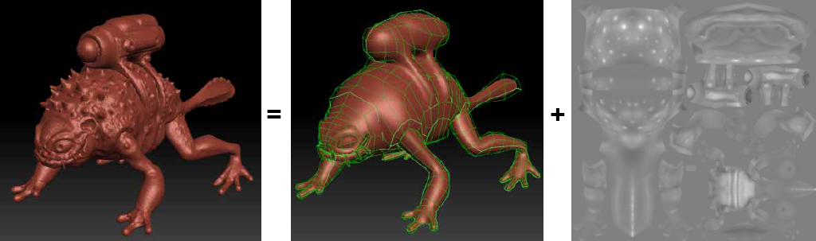
Introduction
A highly detailed mesh can be sent to the card as a simple mesh and a displacement map
Trades ALU operations for memory bandwidth
ALUs scale faster than bandwidth

Slide 14
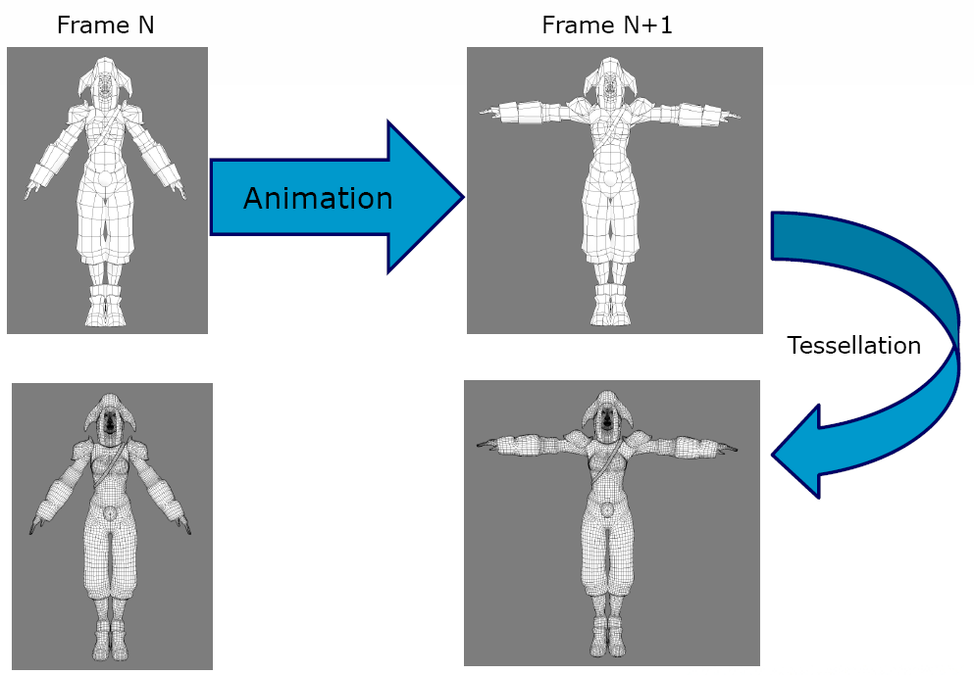
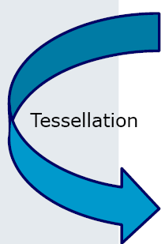
Introduction
Tessellation can also be used by Animators to make their job easier
Animate a low polygon mesh
Tessellate and get detail for free

Slide 15
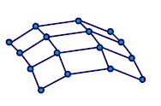
Implementation
New “patch” primitive defined by a set of control points
Operation called refinement generates triangle from each patch

Slide 16
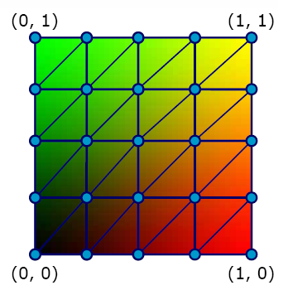
Implementation
Per-patch operations
Level of Detail computation
Transfer of Basis
Bezier -> B-spline
B-spline -> NURBS
Etc.
Generating topology
Generates a set of (u,v)-points in the tessellation domain

Slide 17
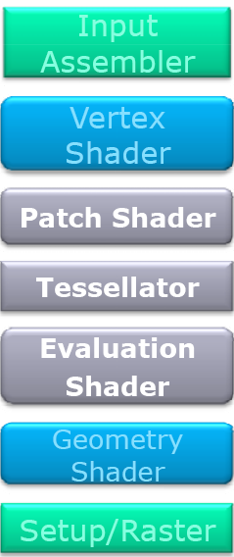
The “Future”
Programmable hardware tessellation
3 stages
2 programmable shaders
1 fixed function configurable tessellator
New primitive “patch”
Curved surface
Easily converted to triangles

Slide 18
Why Wait?
Programmable tessellation can be imitated using DirectX 10 features:
Geometry Shader and Instancing 2.0

Slide 19
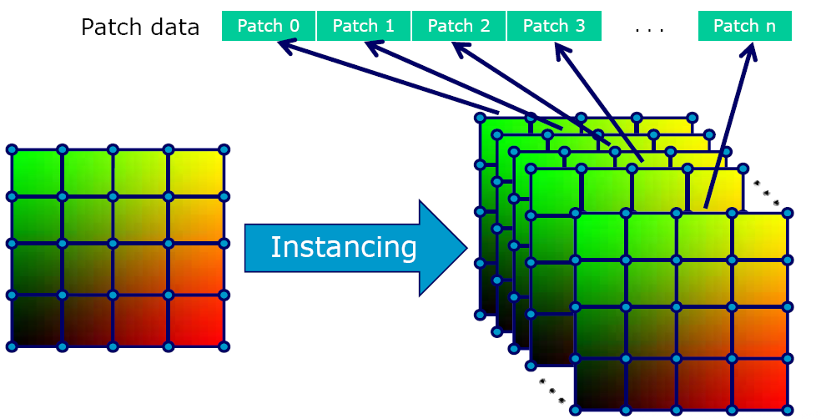
Implementation Details
Geometry Shader cannot do tessellation itself
Outputs triangles serially
Maximum output size of 1024 scalars
16x16 grid of float4s
Instead we can save small pre-tessellated patches as instances

Slide 20
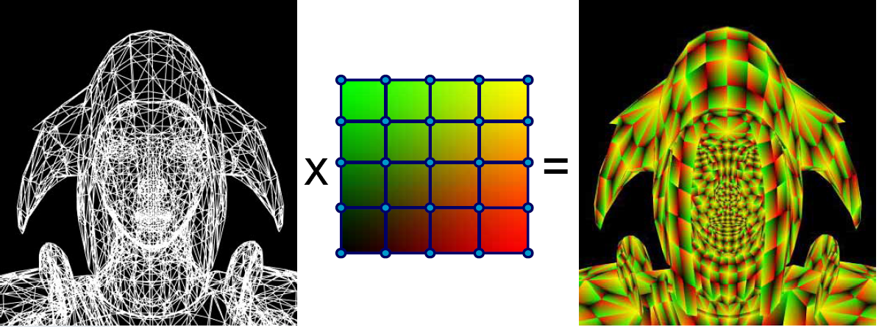
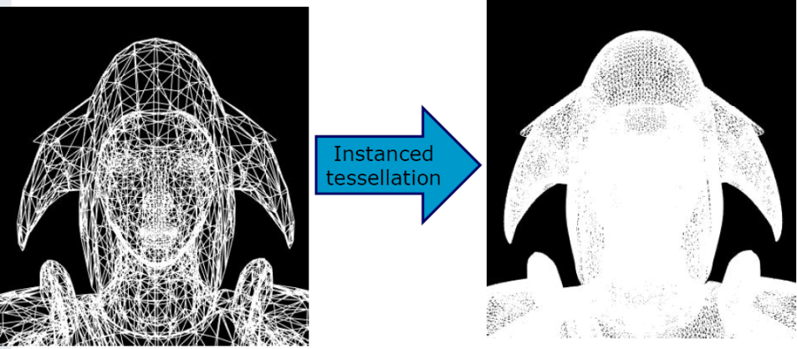
Implementation Details
The pre-tessellated patches represent the results of tessellating every input patch
This data is combined in the vertex shader to produce the desired effects

Slide 21
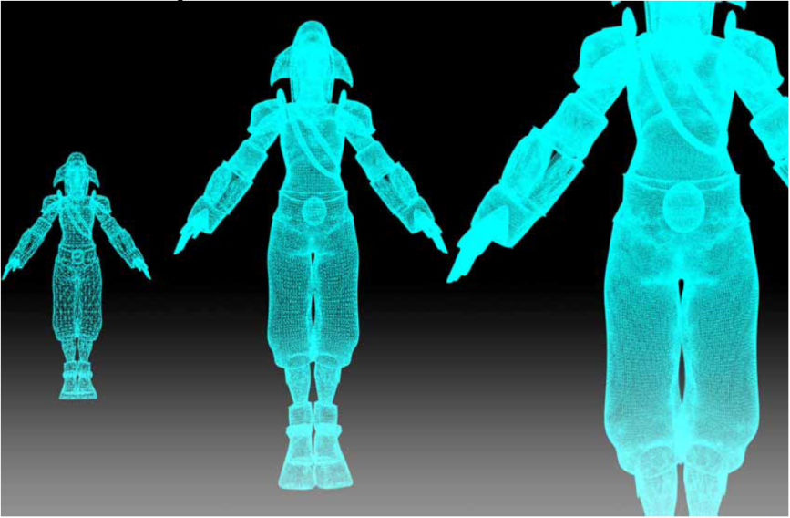
Implementation Details
Vertex shader inputs are too small to handle an entire mesh
Must be bound to shared buffers
The tessellation mesh instances are of varying quality, a LoD factor is used to determine which mesh to select

Slide 22
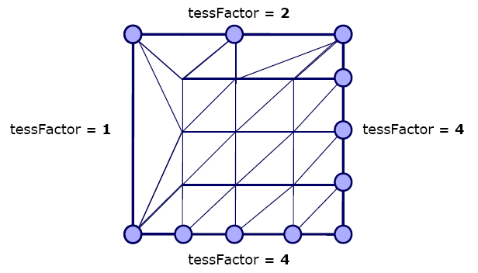
Implementation Details
Tessellation factors can change across a mesh as each patch edge has its own tessFactor.

Slide 23
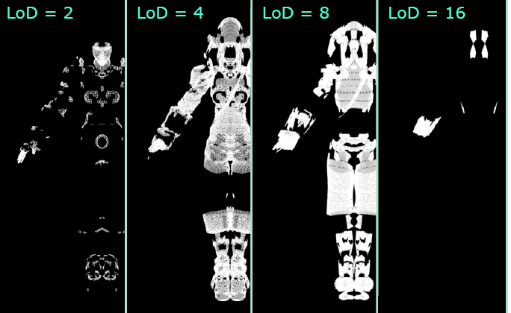
Implementation Details
Per-patch tessellation factors requires multiple draw calls (it won’t in DX11)

Slide 24
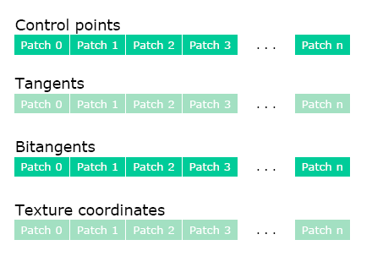
Implementation Details
Since all of the meshes are stored in vertex buffers the only inputs are the primitive id and the vertex id
U = Vertex ID mod LoD
V = Vertex ID div LoD
LoD is based on vertex position

Slide 25
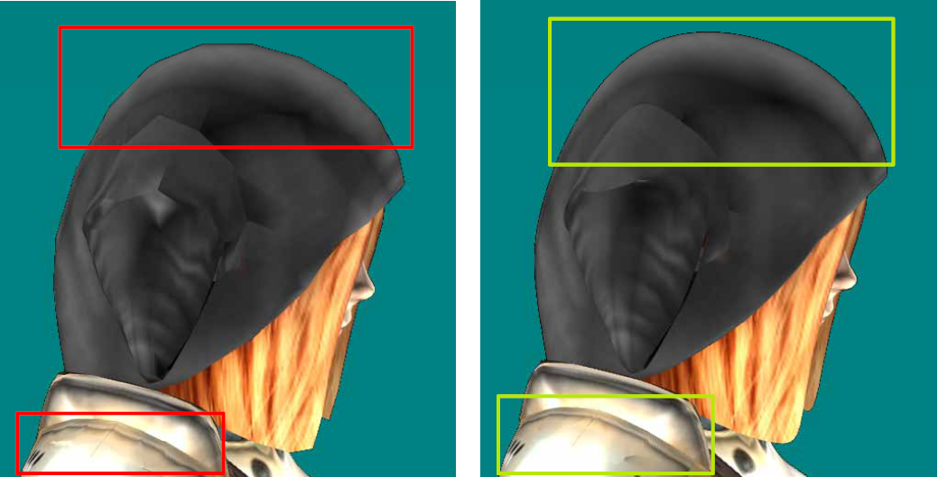
Results

Slide 26
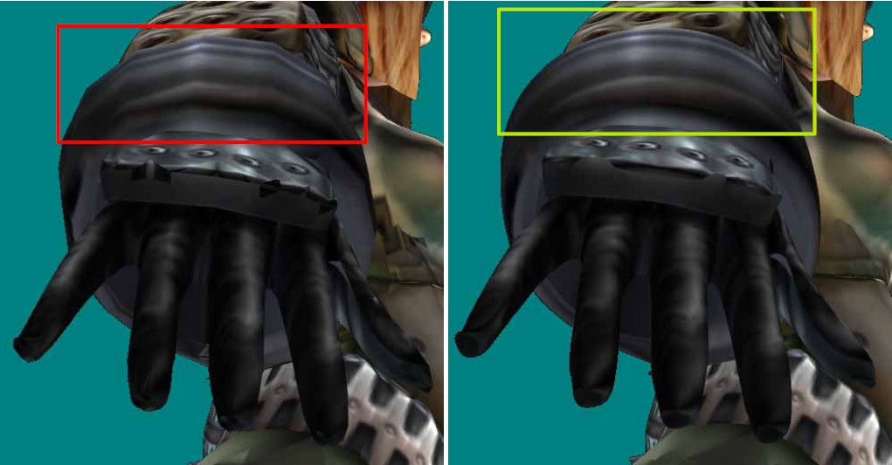
Results

Slide 27
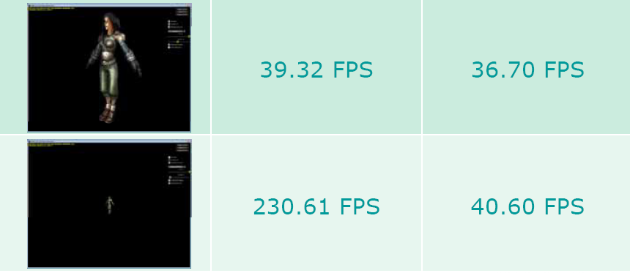
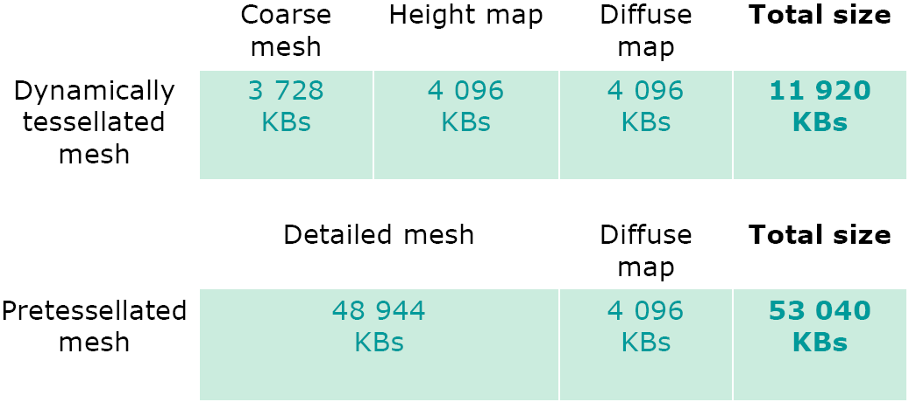
Results
Mesh: 6118 patches, 256 vertices each, 8800 GT

Slide 28
Demo

Slide 29
Takeaways
Tessellation presents a means of significantly increasing detail without a performance cost
Tessellation is possible with DirectX 10
Some of the hiccups with the DirectX 10 implementation will be fixed by future hardware implementations

Slide 30
Introduction to the Direct3D 11 Graphics Pipeline
Kevin Gee

Slide 31
DirectX 11 Tessellation
D3D11 HW Feature
Required for DirectX 11 compatibility
D3D11 Only
No direct backwards compatibility
Fundamental primitive is “patch”
Not triangles
Superset of Xbox 360 tessellation

Slide 32
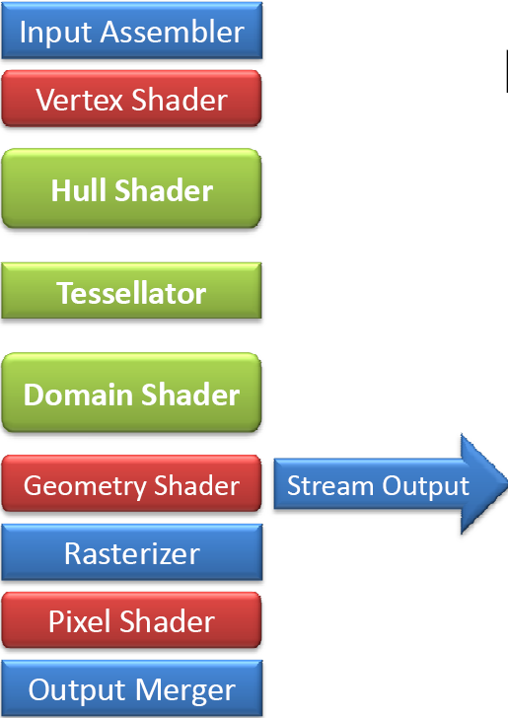
New Pipeline
3 new stages added for Tessellation

Slide 33
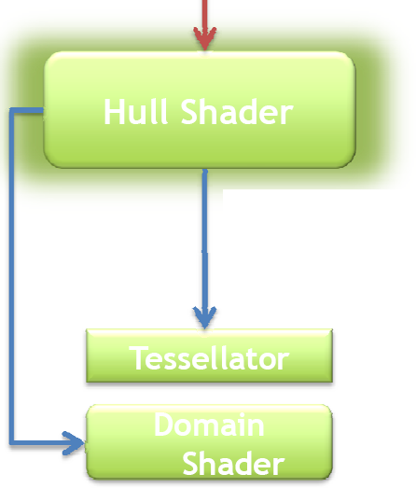
Hull Shader
Programmable
Takes patch control points as an input
2 Output paths:
Output of basis converted control points to Domain Shader
Output of the control points, a tessellation factor, and tessellation modes to the Tessallator

Slide 34
Fixed-Function Tessellator
Tessellator operates on a per patch basis
Again 2 output paths:
Outputs U,V points to Domain Shader for further shading
Outputs topology for primitive assembly

Slide 35
Domain Shader
Either receives a set of points from the Hull Shader or the Tessellator.
The Domain Shader is invoked once per point
It outputs verticies

Slide 36
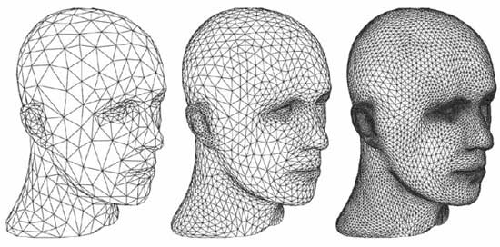
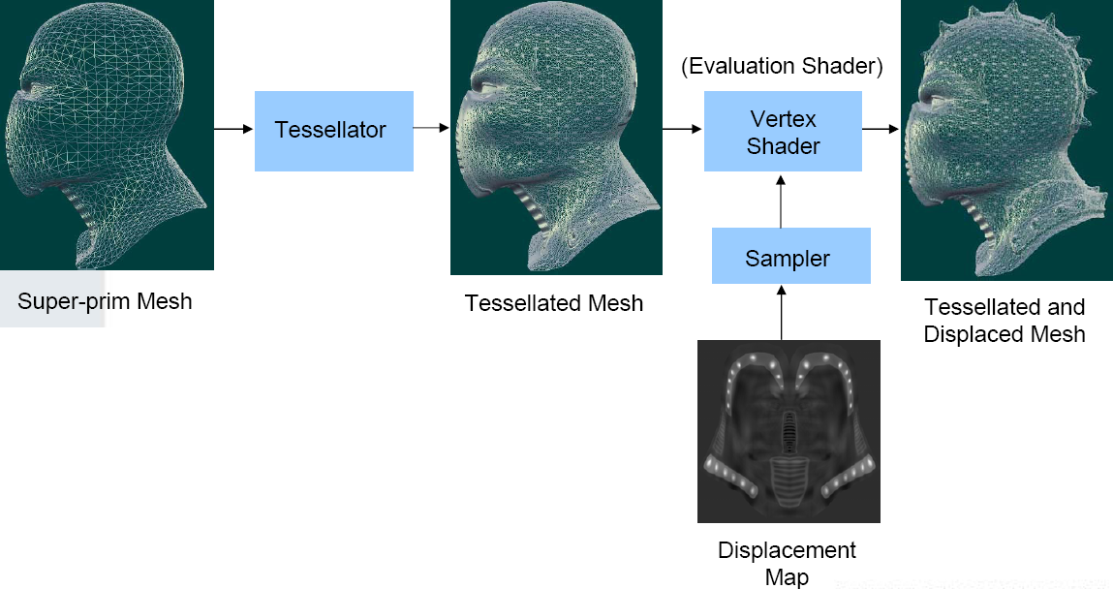
Video
Images courtesy of ATI

Slide 37
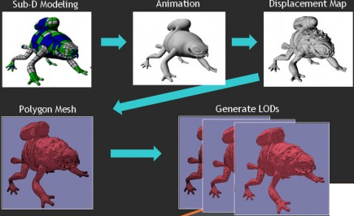
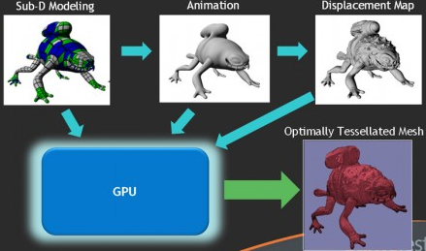
Applications
Creates a new authoring pipeline
1-pass process from input to optimally tessellated mesh
Makes both animation and real-time applications faster
Allows for a higher level of detail
Images courtesy of NVIDIA Gamefest 2008

Slide 38
Tessellation of Displaced Subdivision Surfaces in DX11
Ignacio Castano

Slide 39
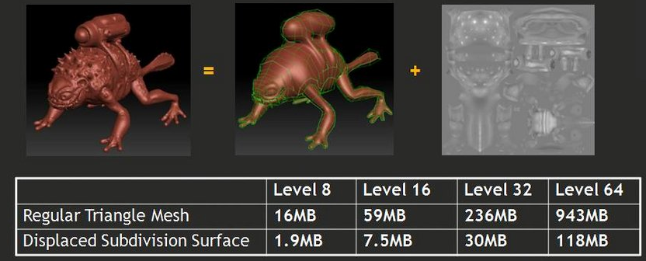
Introduction
Tessellation lets us send down low polygon meshes to save memory and bandwidth which are the main bottlenecks

Slide 40
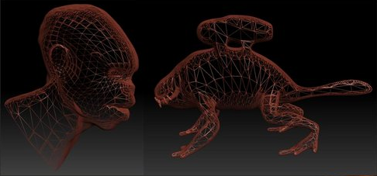
Scalability
Tessellation allows for view dependent levels of detail so the GPU doesn’t waste time rendering unseen triangles.

Slide 41
Subdivision Surfaces
Subdivision Surfaces are a well explored technique for increasing the detail of a mesh.
Previous GPU implementations required multiple GPU passes
The new DirectX 11 tessellation hardware allows us to do subdivision surfaces in a single pass

Slide 42
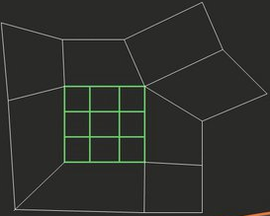
Hull Shader
The hull shader is used for control point evaluation.
Input is a face and its neighboorhood
Output is a regular bicubic bezier patch of the face

Slide 43
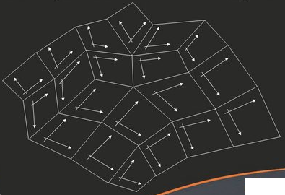
Domain Shader
The Domain Shader evaluates the bicubic Bezier patches and corresponding tangents
Reorders face patches for consistent adjacency
Requires 69 instructions

Slide 44
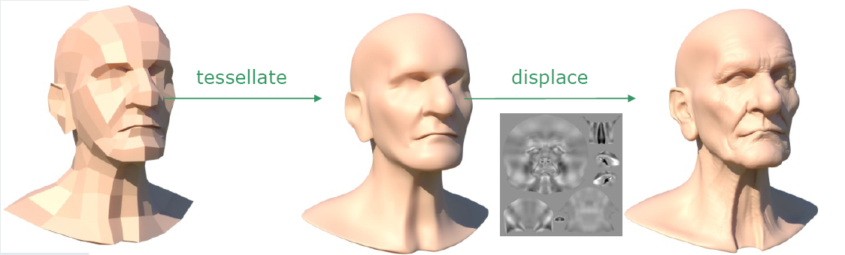
Results

Slide 45
References
Tatarchuk N.: Dynamic Terrain Rendering on GPU Using Real-Time Tessellation. ShaderX⁷ (Dec. 2008).
Tatarinov, A.: Instanced Tessellation in DirectX10. GDC 2008. February 2008.
Gee, K.: Introduction to the Direct3D 11 Graphics Pipeline. Nvision 2008.
Castano, I.: Tessellation of Displaced Subdivision Surfaces in DX11. Gamefest 2008

